Slide 1


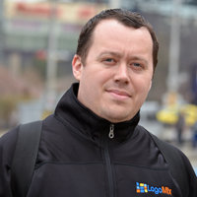


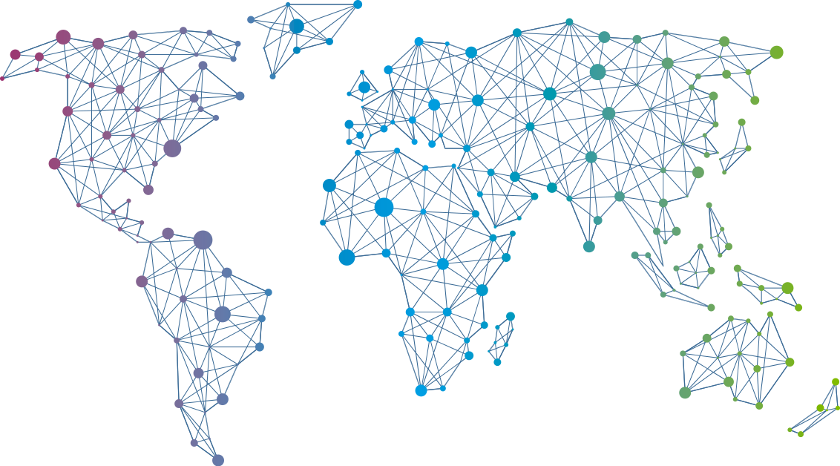

Speaker
Marton Kodok
Cloud Workflows - Automate your Cloud services
Marton Kodok
MartonKodok
September 16th & 17th
^{Online Event}
Powered By
International Conference

